Slide 1
Treasurer Interim Report for AGM Feb 2021
Co’path and Cove CC Apr 2020 – Jan/ Feb 2021
Note: CCCC Financial Year concludes end of March 2021
Karen Nelson 10 COVE

Slide 2
Content – CCCC Treasurer Report
CCCC Finances Background
Points to Note to Support the Report
Running the Council Account Transactions
Community Benefits Account Transactions
Community Benefits Balances
Community Benefits Income
Community Benefits Allocated and Snapshot
Summary

Slide 3
CCCC Finances - Background
Managed via two BoS Current Accounts:
  Run the council
  Community Benefits
Two of three signatories for each Cheque / Standing Order
  Chair Pauline Hood
  Secretary Kate Tulloch
  Treasurer Karen Nelson
Income and Expenditure
  Examined and Signed off annually by a member of the community
  Used to apply for the SBC annual CC Grant currently £630 p.a.
  Excel file with transactions Apr 2020 - Jan/Feb 2021 shared with CC members
  (Copy available on request and snapshots in this presentation for easy reference)

Slide 4
Points to Note to Support Report
Please Note:
The figures outlined in the following slides are intended to give an overview of the annual account activity for both accounts with more focus on the Community Benefits. Aim of this report is to focus on the financial transactions rather than detail of the Community Benefits applications.
In the interest of keeping it simple, figures have been rounded for the charts. As there are numerous transaction in the Benefits account and tricky to read on one slide, snapshots of the workbook are included and intended to support the detail available in a copy of the excel file. Although the main aim is to reflect this financial year (2020 to 2021) some additional detail has been included in the benefits charts from last year for information, for example Fishermen 3 benefit paid mid March 2020.
Running the Council account functions on a balance of around £1,000.
Community Benefits account has a current balance of around £203,000*. (29/1/2021)
*approx. £5,000 of this balance is held for ‘Other’ areas including the BHA £4K

Slide 5
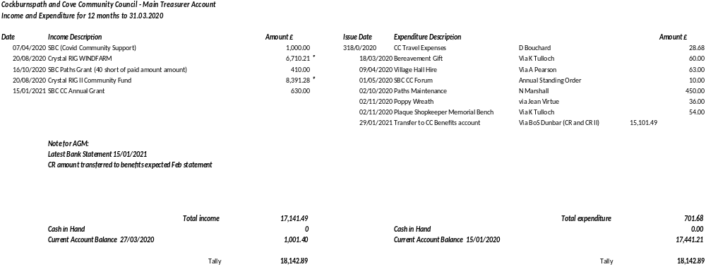
Running the CC - Transactions Apr’20 to Jan‘21

Slide 6
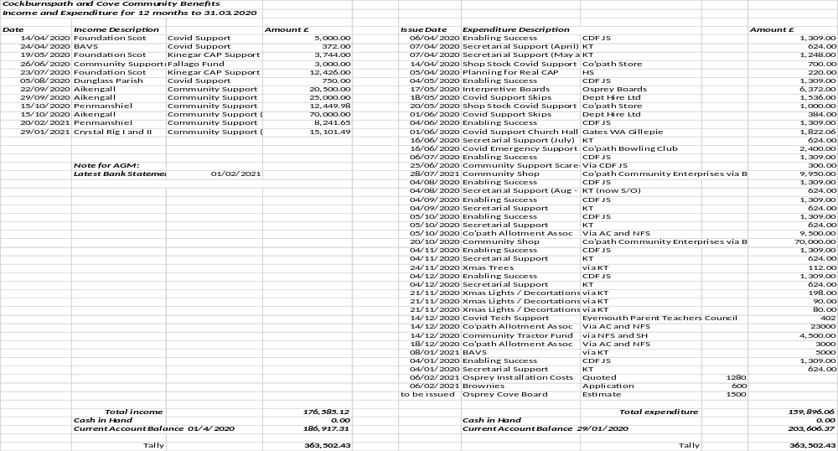
Community Benefits – Transactions Apr’20 to Jan‘21

Slide 7
Benefits Key Balances
Aikengall 45,000.00
BHA 4,000.00
CR I 16,000.00
CR II 20,000.00
Fernylea 7,500.00
Fishermen 3 28,500.00
Penmanshiel 77,000.00
* rounded figures

Slide 8
Community Benefits recv’d ‘20 to ‘21
*rounded figures
Note:
Fishermen 3 – March ‘20 prev years report

Slide 9
Benefits Allocated
Apr ‘20 to Feb ‘21 by Category
NOTE approx. amounts for graph:
CAP – Community Action Plan includesCDF and Secretarial costs
Covid – includes Food Bank
Shop - Co’path Enterprises
Educ - includes interpretive boards
Bowl Club – also recv’d £3,600 Mar ’20
Tractor – includes other costs for estate management

Slide 10
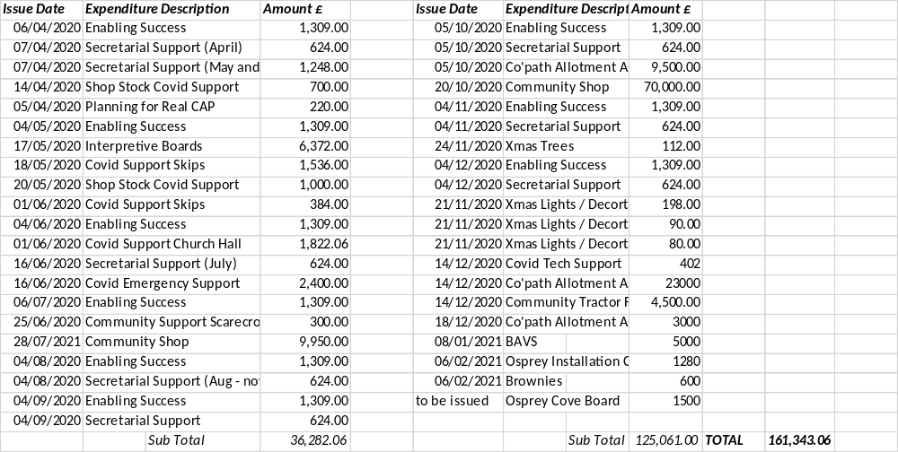
Snapshot actual amounts allocated
Apr 2020 to Feb 2021*
*Note
Jan and Feb items not included in Bank Statements at time of print

Slide 11
Summary
Apologies I will not be with you for the Feb AGM - Happy to follow up with short presentation in March. Happy to talk through any points with individuals and extra keen to talk through all the detail with anyone who may wish to take over as Treasurer.
As you can see there is a healthy sum in our Benefits account, built up over the past few years as agreements with local windfarms have come to fruition. This puts our Community in a good position to support the development of our Community Action Plan.
Appreciate there are already applications in the making for Community Groundsman/ Caretaker, Planning for Real, Going Digital and smaller projects like the Village Hall Playpark rejuvenation.
Bring on 2021!

